Slide 1

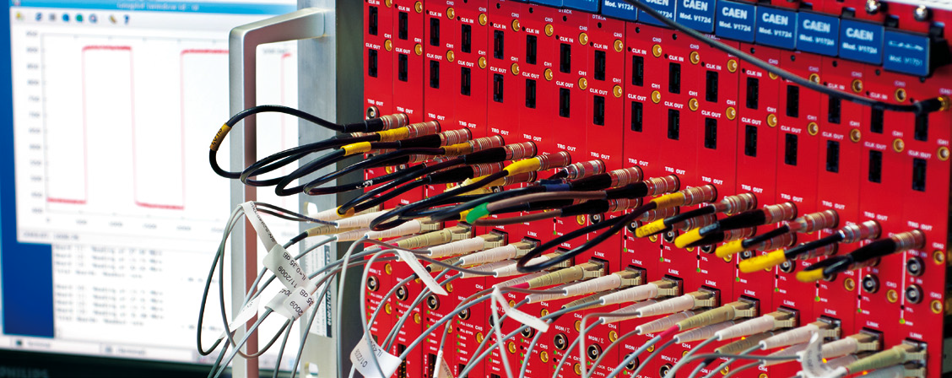
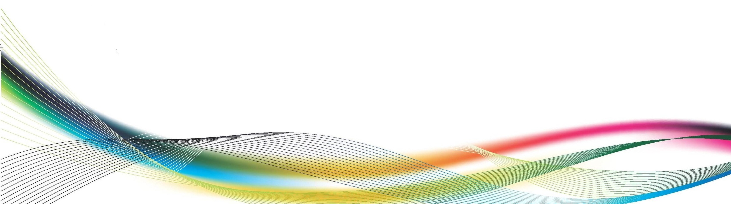


Digitizers for Physics Applications
RT2014 Nara – May 27th 2014
Carlo Tintori
ISO 9001:2008
CERT. N. 9105.CAEN

Slide 2
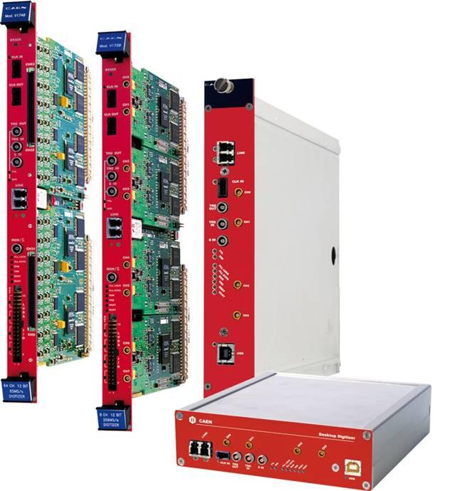
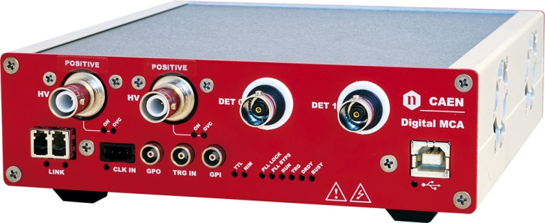
CAEN Digitizers Highlights
VME, NIM, Desktop form factors
Up to 64 channels in a single board
8, 10, 12 and 14 bit; up to 5GS/s
Digital MCA with integrated HV and LV
FPGA firmware for Digital Pulse Processing:
  Pulse Height Analysis
  Pulse Shape Discrimination
  Charge Integration
  CFD and Time stamping
Readout:
  VME up to 160MB/s, shared bus
  Optical Link up to 100 MB/s point to point (PCI/PCIe)
  USB 2.0 up to 30MB/s
Memory buffer: up to 10MB/ch
Multi-board synchronization: clock, synch and trigger distribution
Programmable digital I/Os
On-line coincidence and majority
Software for Windows and Linux
Reproduction, transfer, distribution of part or all of the contents in this document in any form without prior written permission of CAEN S.p.A. is prohibited
Notes:
2

Slide 3
Digitizers Table
MODEL⁽¹⁾ | Form Factor | # channels | Sampling Frequency (MS/s) | # Bits | Input Dynamic Range (Vpp) | Bandwidth (MHz) | Memory (Msample/ch) Record Lenght |  | DPP firmware⁽⁴⁾
 |  |  |  |  |  |  | small | big
x724 | VME | 8 | 100 | 14 | 0.5 - 2.25 - 10 | 40 | 0.5 500μs | 4 4ms | PHA
 | Desktop/NIM | 4
x720 | VME | 8 | 250 | 12 | 2 | 125 | 1.25 5ms | 10 40ms | CI, PSD
 | Desktop/NIM | 4
x730 | VME | 16 | 500 | 14 | 0.5 and 2 ⁽⁵⁾ | 250 | 1.25 250μs | 10 2ms | PHA, PSD⁽⁶⁾
 | Desktop/NIM | 8
x721 | VME | 8 | 500 | 8 | 2 | 250 | 2 2ms |  | -
x731 | VME | 8/4 | 500/1000 | 8 | 2 | 250/500 | 2/4 2ms |  | -
 | Desktop/NIM | 4/2
x751 | VME | 8 | 1000/2000 | 10 | 1 | 500 | 1.8/3.6 1.8ms | 14.4/28.8 14.4ms | PSD, ZLE
 | Desktop/NIM | 4
x761 | VME | 2 | 4000 | 10 | 1 | 1000 | 7.2 1.8ms | 57.6 14.4ms | -
 | Desktop/NIM | 1
x740 | VME | 64 | 62.5 | 12 | 2 - 10 | 30 | 0.19 3ms | 1.5 24ms | -
 | Desktop/NIM | 32
x742 | VME | 32+2 | 5000⁽²⁾ | 12 | 1 | 600 | 0.128⁽³⁾ 200ns |  | -
 | Desktop/NIM | 16+1
x743 | VME | 16 | 3200⁽²⁾ | 12 | 2.5 | 500 | 0.003⁽⁷⁾ 640ns |  | CM
 | Desktop/NIM | 8
(1) The x in the model name is V1 for VME, VX1 for VME64X, DT5 for Desktop and N6 for NIM
(2) Sampling frequency of the analog memory (switched capacitor array); A/D conversion takes place at lower speed (dead-time)
(3) The memory size for the x742 is 128 events of 1024 samples each. Record length can be 200 ns, 500 ns or 1 μs depending on the sampling frequency
(4) DPP-PHA: Pulse Height analysis (Trapezoidal Filters), DPP-CI and CM: Charge Integration (digital QDC); DPP-PSD: n/γ Discrimination (double gate charge)
(5) Input dynamic range with 2 options software selectable
(6) PSD available from Q4-2013, PHA available from Q4-2014
(7) The memory size for the x743 is 3 events of 1024 samples each
Reproduction, transfer, distribution of part or all of the contents in this document in any form without prior written permission of CAEN S.p.A. is prohibited
Notes:
3

Slide 4
Readout Modes
CONET2 (1.25 Gb/s Optical Link):
  Up to ~100MB/s per link
  Daisy chainable (up to 8 boards)
  A2818 PCI (1 link), A3818 PCIe (1, 2 or 4 links)
VME64X
  MBLT (~70MB), 2eVME and 2eSST (~150MB) data readout
  Chained Block Transfer
  Backplane shared between boards (shared bandwidth)
USB 2.0
  ~30MB/s max bandwidth
  No external hardware required
  Easy to use (e.g. portable systems, laptops, etc…)
Reproduction, transfer, distribution of part or all of the contents in this document in any form without prior written permission of CAEN S.p.A. is prohibited
Notes:
4

Slide 5
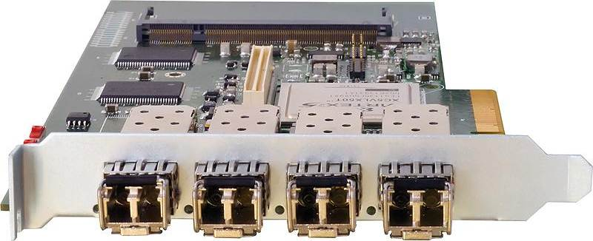
CONET2 readout example: XMASS
64 V1751 modules in 4 VME crates
512 channels (10 bit @ 1GHz)
4 A3818s 4 link PCIe cards
16 parallel CONET2 links
4 digitizers daisy chained
Readout Bandwidth = ~2 MB/s/ch
Total Bandwidth = ~ 1GB/s
Reproduction, transfer, distribution of part or all of the contents in this document in any form without prior written permission of CAEN S.p.A. is prohibited
Notes:
5

Slide 6
Digitizers for Physics applications
Designed for System scalability (Modular Electronics)
Multi Board Synchronization
On line Digital Pulse Processing (DPP):
  Individual pulse triggering
  Time stamp with LED of CFD discriminators + interpolation
  Baseline subtraction
  Energy calculation (pulse height or charge)
  Pulse Shape Discrimination
  Waveform Readout (optional)
  Coincidence or trigger propagation between channels
On-line DPP allows for a significant throughput rate reduction; this is mandatory for most physics applications
Reproduction, transfer, distribution of part or all of the contents in this document in any form without prior written permission of CAEN S.p.A. is prohibited
Notes:
6

Slide 7
Traditional acquisition chain
Traditional acquisition chains are made of a number of analog modules interconnected with cables
A/D conversion at the end of the chain
Peak
Sensing
ADC
Energy
Delay
QDC
Charge
Detector
Amplif
Gate
pre
splitter
Coinc
Scaler
Counts
Discr
TDC
Time
Reproduction, transfer, distribution of part or all of the contents in this document in any form without prior written permission of CAEN S.p.A. is prohibited
Notes:
7

Slide 8
Fully digital acquisition chain
Nowadays fast and high resolution flash ADCs allow designers to make acquisition systems in which the A to D conversion occurs as close as possible to the detector
Digitizer
Waveform
Detector
Energy
ADC
FPGA
Charge
pre
Count
Time
Shape
Algorithms
The aim of the DPP is to make a “all in digital” version of analog modules such as Shaping Amplifiers, Discriminators, QDCs, Peak Sensing ADCs, TDCs, Scalers, Coincidence Units, etc.
Reproduction, transfer, distribution of part or all of the contents in this document in any form without prior written permission of CAEN S.p.A. is prohibited
Notes:
8

Slide 9
Benefits of the digital approach
One single board can do the job of several analog modules
A/D conversion as early as possible, data reduction as late as possible: preserve full information!
Correlation of different information (e.g. timing and energy available from the same data readout): multi-parametric analysis
Reduction in size, cabling, power consumption and cost per channel
High reliability and reproducibility
Flexibility: different digital algorithms can be designed and loaded at any time into the same hardware
Reproduction, transfer, distribution of part or all of the contents in this document in any form without prior written permission of CAEN S.p.A. is prohibited
Notes:
9

Slide 10
DIGITAL DETECTOR EMULATOR
Reproduction, transfer, distribution of part or all of the contents in this document in any form without prior written permission of CAEN S.p.A. is prohibited
Notes:
10

Slide 11
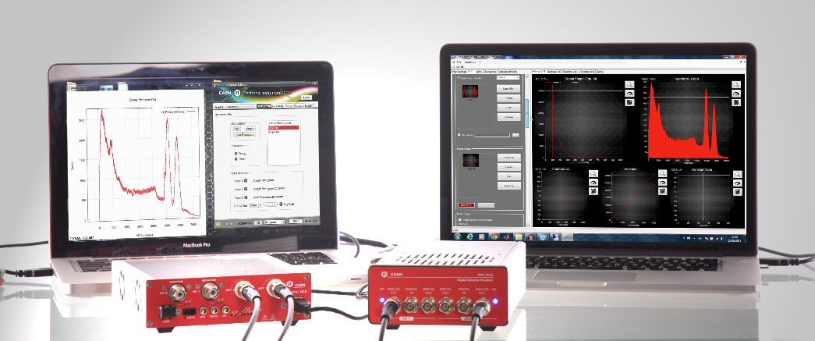
What is a Digital Detector Emulator
NOT a pulse generator of recorded shapes
BUT a synthesizer of true random pulses compliant to programmable statistics for amplitude, starting time and shape
Reproduction, transfer, distribution of part or all of the contents in this document in any form without prior written permission of CAEN S.p.A. is prohibited
Notes:
11

Slide 12
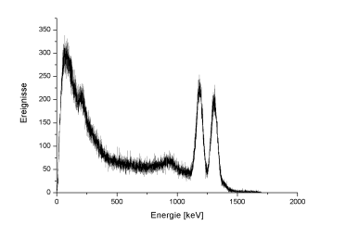
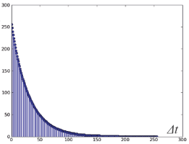
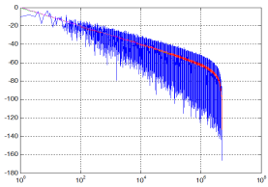
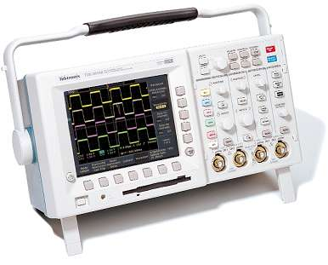
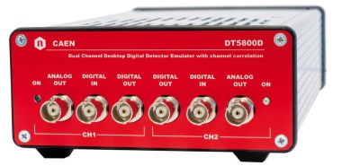
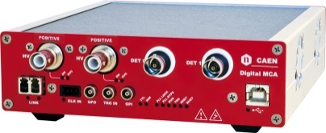
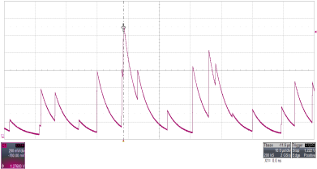
DDE operating mode
ENERGY SPECTRUM
TIME DISTRIBUTION
PULSE SHAPE
NOISE + BASELINE DRIFT
DDE
MCA
EMULATED SIGNALS
ENERGY SPECTRUM
Reproduction, transfer, distribution of part or all of the contents in this document in any form without prior written permission of CAEN S.p.A. is prohibited
Notes:
12

Slide 13
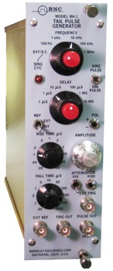
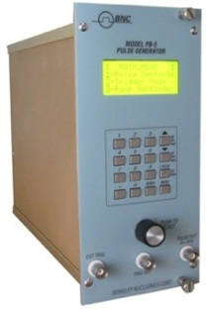
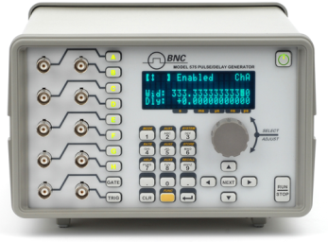
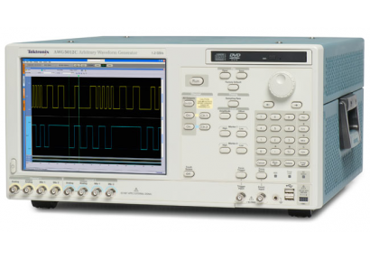
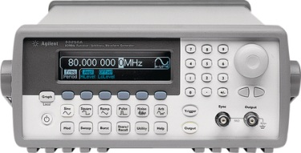
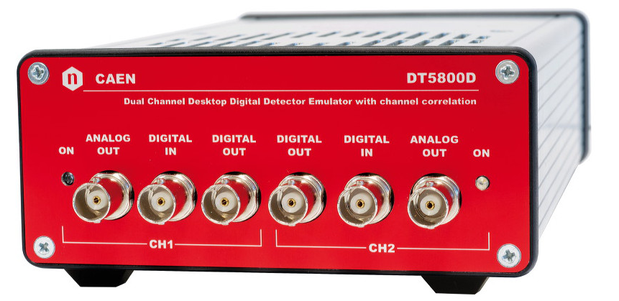
DDE: a full featured instrument
PULSER
TAIL GENERATOR
WAVEFORM GENERATOR
WAVEFORM RECORDER
ps PULSE GENERATOR
Reproduction, transfer, distribution of part or all of the contents in this document in any form without prior written permission of CAEN S.p.A. is prohibited
Notes:
13

Slide 14
DDE Highlights
Two analog channels (125MHz, 14bit DAC) + 4 digital I/Os
Random or periodic Pulse Generator emulating a programmable energy spectrum and a poissonian statistic emission with pile-up
Programmable Pulse Shape; dual-shape option for pulse shape discrimination tests
Transistor Reset Preamplifier emulation
Noise emulation (1/f, baseline drift, white noise, interference)
Correlated event emulation (with given energy spectrum and delay in steps of 11 ps) mixed in an uncorrelated background
Arbitrary Waveform generator (sine, square, triangular, pulses, …)
Isotopes database
Software and drivers for Windows
Reproduction, transfer, distribution of part or all of the contents in this document in any form without prior written permission of CAEN S.p.A. is prohibited
Notes:
14

Slide 15
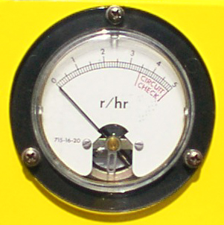

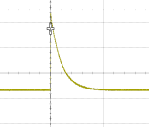

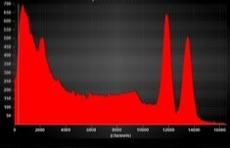
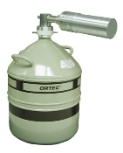
DDE Application Example 1
signals recorded with a weak source (low rate)
reproduction at high rate emulating a strong source
Rate
Files
Emulated Setup
Real Setup
Educational: MCA training to students without sources and detectors
Reproduction, transfer, distribution of part or all of the contents in this document in any form without prior written permission of CAEN S.p.A. is prohibited
Notes:
15

Slide 16
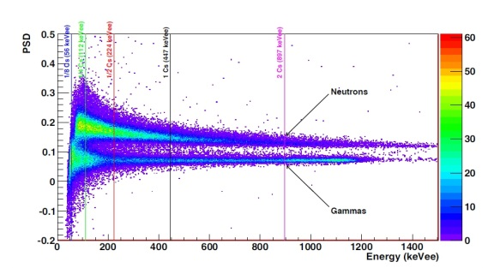
DDE Application Example 2
Neutron
Source
neutron
SHAPE 1
γ ray
SHAPE 2
shape1/shape2 ratio
80%
SHAPE 1
SHAPE 2
20%
Reproduction, transfer, distribution of part or all of the contents in this document in any form without prior written permission of CAEN S.p.A. is prohibited
Notes:
16

Slide 17
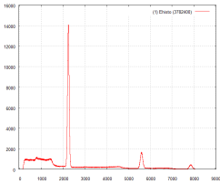


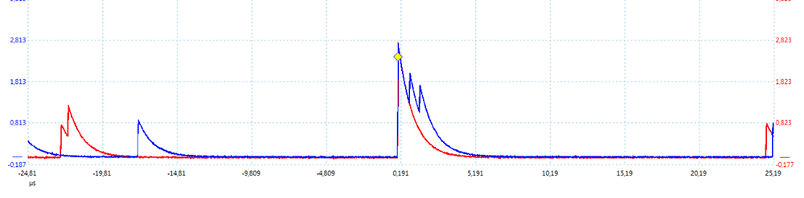
DDE Application Example 3
Uncorrelated
background
CH1
CH2
²²Na
Correlated Events
CH1
CH2
Reproduction, transfer, distribution of part or all of the contents in this document in any form without prior written permission of CAEN S.p.A. is prohibited
Notes:
17

Slide 18
PULSE HEIGHT ANALYSIS
Reproduction, transfer, distribution of part or all of the contents in this document in any form without prior written permission of CAEN S.p.A. is prohibited
Notes:
18

Slide 19
DPP-PHA topics
Digital Multi-Channel Analyzer:
Replaces the analog chain with shaping amplifier + peak sensing ADC
Takes the output signal of the Charge Sensitive Preamplifier
Implemented in the 14 bit, 100MSps digitizers (x724 models) and DT5780 digital MCA (that includes also High and Low Voltage supply) and DT5781. Coming soon on x730 modules (14 bit, 500MSps).
Provides pulse height, time stamp and optionally raw waveforms
Pile-up rejection, Baseline restoration, ballistic deficit correction
Best suited for high resolution spectroscopy (HPGe and Si detectors) as well as low cost solutions such as NaI, CsI, etc…
Multiple channel systems for clover or segmented detectors, compton suppression, cosmic veto, low background spectroscopy, etc…

Slide 20
DPP-PHA Block Diagram
Waveforms
Event
Builder
sync
TimeStamp
Trigger Threshold
clk
Counter
Arm
Output
Data
Trigger & Timing
Filter
Self-Trigger
ZC
Input
Deci
mator
Energy
Filter
+
Energy
Peak
Freeze
-
Baseline
PUR
Reject
Coinc
Memory
Buffers
Reproduction, transfer, distribution of part or all of the contents in this document in any form without prior written permission of CAEN S.p.A. is prohibited
Notes:
20

Slide 21
DPP-PHA signals
Reproduction, transfer, distribution of part or all of the contents in this document in any form without prior written permission of CAEN S.p.A. is prohibited
Notes:
21

Slide 22
Pile-up in the Trapezoidal Filter
Case 1: ΔT > T_{TR}+T_{TF} (2nd trapezoid starts on the falling edge of the 1st one). Both energies are good (no pile-up events)
Case 2: ~T_{PR} < ΔT < T_{TR}+T_{TF} (2nd trapezoid starts on the rising edge or flat top of the 1st one). Pulse height calculation is not possible, no energy information is available (pile-up events); still two time stamps.
Case 3: ΔT < ~T_{PR} (input pulses piling up on their rising edge). The TT filter doesn’t distinguish the double pulse condition. Only one event is recorded (energy sum). The Rise Time Discriminator might mitigate this unwanted effect.
Reproduction, transfer, distribution of part or all of the contents in this document in any form without prior written permission of CAEN S.p.A. is prohibited
Notes:
22

Slide 23
Test Results with HPGe and DT5780
Test Conditions
MCA | DT5780
Detector | Canberra coaxial HPGe Mod. 7229P
Preamplifier | model 2001
HV bias | 4.5 kV
Sources | ⁶⁰Co, ¹³⁷Cs, ²⁴¹Am, ²⁰⁴Tl
Counting rate | 100 - 500 Hz
Measured Dead time | < 2%
DPP parameter | value
Pole zero time constant | 47 μs
# Samples for Baseline | 1024
Trapezoid Rise Time | 5.0 μs
Trapezoid Flat Top | 2.0 μs
Peaking Delay | 1.5 μs
Baseline Holdoff | 0.1 μs
Peak Holdoff | 20.0 μs
Energy (KeV) | Centroid (KeV) | FWHM (KeV)
59.541 | 59.521 +- 0.004 | 0.95 +- 0.01
68.895 | 68.910 +- 0.010 | 1.04 +- 0.03
70.819 | 70.809 +- 0.006 | 0.98 +- 0.01
661.659 | 661.716 +- 0.008 | 1.37 +- 0.01
1173.240 | 1173.233 +- 0.006 | 1.68 +- 0.01
1332.508 | 1332.487 +- 0.008 | 1.77 +- 0.01
1460.822 | 1460.833 +- 0.033 | 1.76 +- 0.06
Reproduction, transfer, distribution of part or all of the contents in this document in any form without prior written permission of CAEN S.p.A. is prohibited
Notes:
23

Slide 24
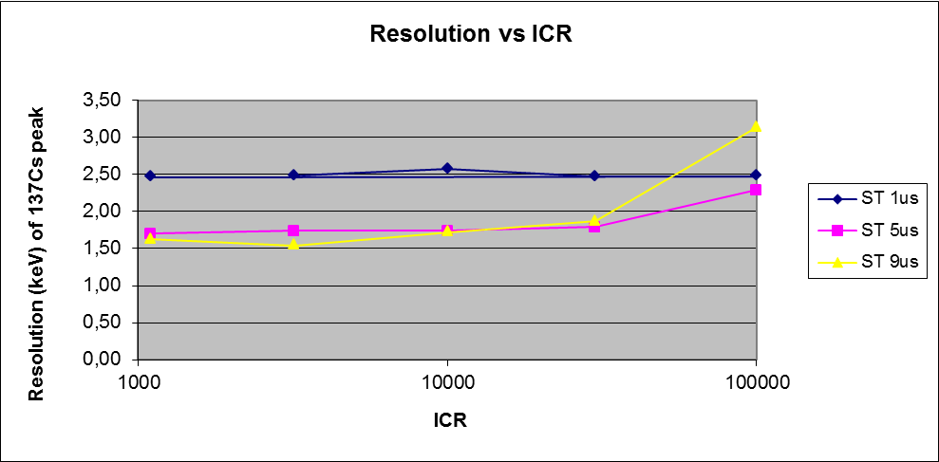
Test Results with HPGe and DT5724 (I)
Reproduction, transfer, distribution of part or all of the contents in this document in any form without prior written permission of CAEN S.p.A. is prohibited
Notes:
24

Slide 25
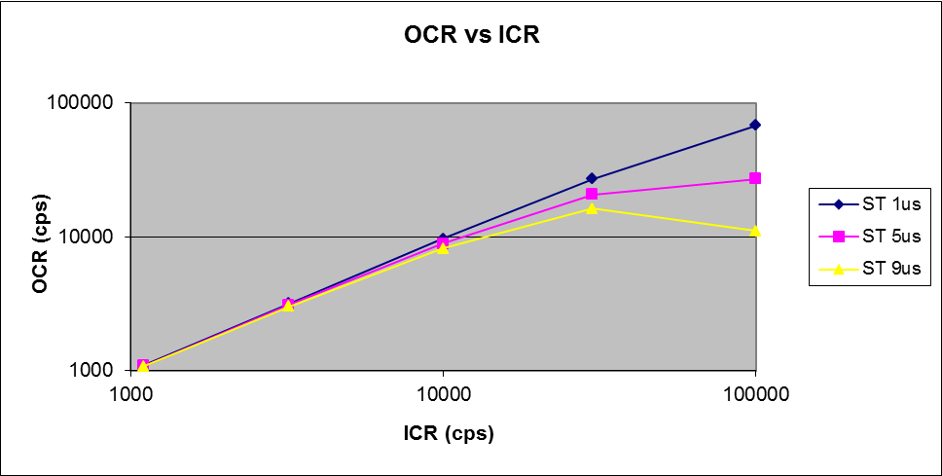
Test Results with HPGe and DT5724 (III)
Reproduction, transfer, distribution of part or all of the contents in this document in any form without prior written permission of CAEN S.p.A. is prohibited
Notes:
25

Slide 26
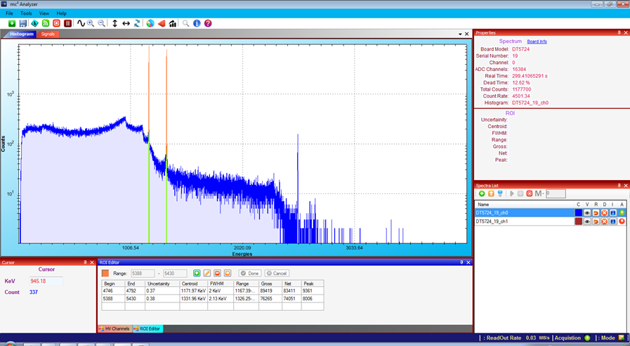
MC² Analyzer
Reproduction, transfer, distribution of part or all of the contents in this document in any form without prior written permission of CAEN S.p.A. is prohibited
Notes:
26

Slide 27
CHARGE INTEGRATION &
PULSE SHAPE DISCRIMINATION
Reproduction, transfer, distribution of part or all of the contents in this document in any form without prior written permission of CAEN S.p.A. is prohibited
Notes:
27

Slide 28
DPP-CI/PSD topics
Digital implementation of the QDC + discriminator and gate generator
CI: single gate; PSD: dual gate (fast and slow component)
Pulse Shape Discrimination for n-γ separation
PSD = (Q_{LONG} - Q_{SHORT})/Q_{LONG}
Available for x720 (12 bit @ 250MS/s), x751 (10 bit @ 1GS/s) and x730 (14 bit @ 500MS/s) and DT5790 (2 channel 12 bit @ 250MS/s + 2 High Voltage + 2 Low Voltage for preamps)
Digital CFD with time stamp interpolation (in x730 only)
Self-gating integration; no delay line to fit the pulse within the gate
Pile-up rejection or gate re-triggering
PSD cut suppress events with above/below a programmable PSD threshold (e.g. suppress gammas in low neutron counting rate cases)
Typically used with scintillators + PMT or SiPM/MPPC
Reproduction, transfer, distribution of part or all of the contents in this document in any form without prior written permission of CAEN S.p.A. is prohibited
Notes:
28

Slide 29
DPP-PSD Block Diagram
PSD Threshold
PSD
Waveform
Event
Builder
QL
Data
Input
Delay
Charge
Accumulator
QS
Baseline
-
Short
Gate
Long
Gate
Time Stamp
+
Discr
Clock
Counter
Trigger Threshold
Trigger
PUR
Reproduction, transfer, distribution of part or all of the contents in this document in any form without prior written permission of CAEN S.p.A. is prohibited
Notes:
29

Slide 30
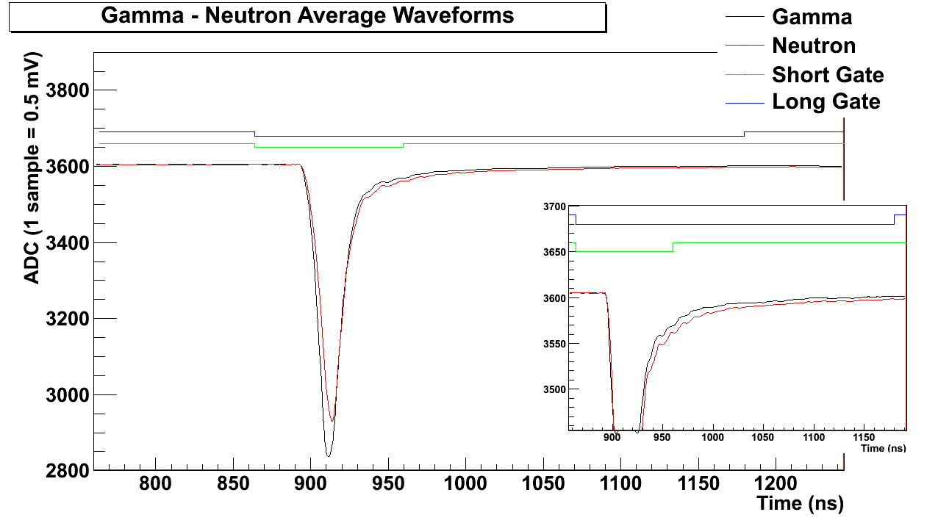
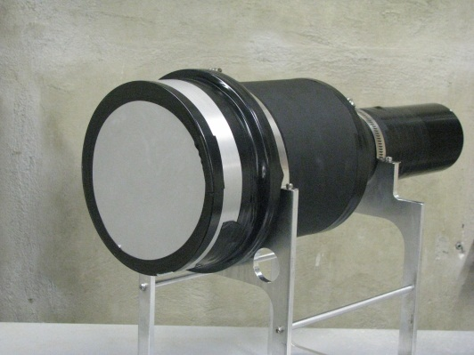
γ-n Discrimination: test results (I)
Detector: BC501A 5x2 inches,
PMT: Hamamatsu R1250
Board: DT5270 with DPP-PSD
Reproduction, transfer, distribution of part or all of the contents in this document in any form without prior written permission of CAEN S.p.A. is prohibited
Notes:
30

Slide 31
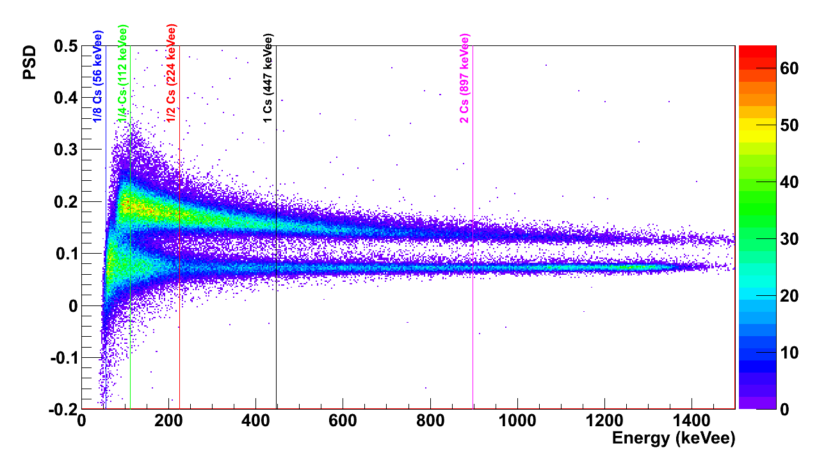
γ-n Discrimination: test results (II)
Reproduction, transfer, distribution of part or all of the contents in this document in any form without prior written permission of CAEN S.p.A. is prohibited
Notes:
31

Slide 32
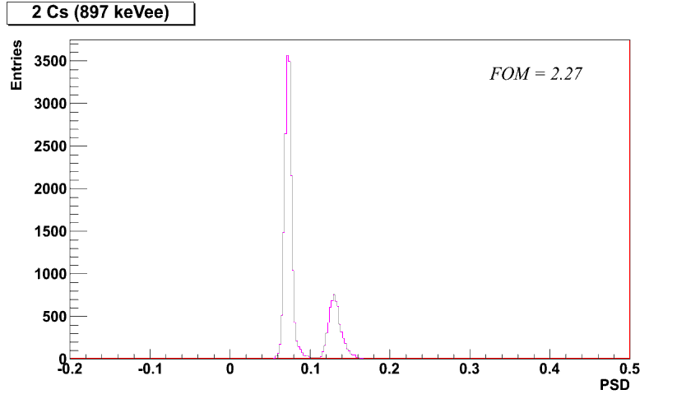
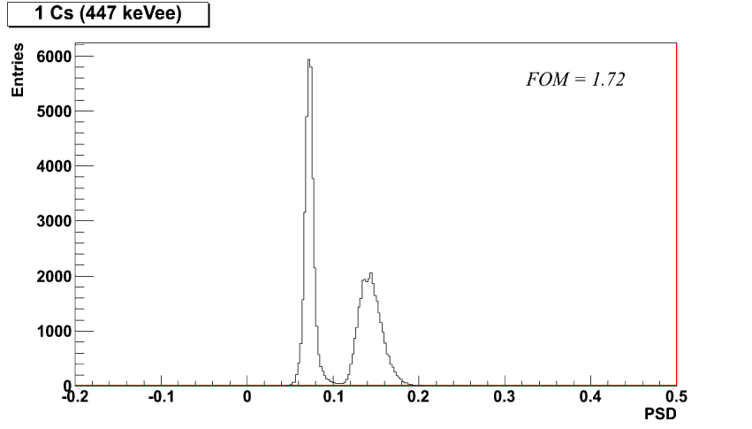
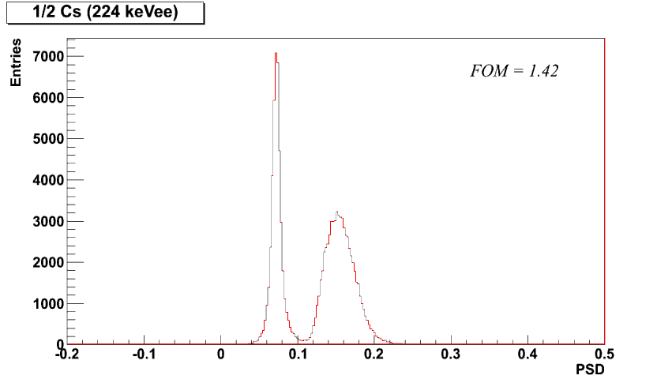
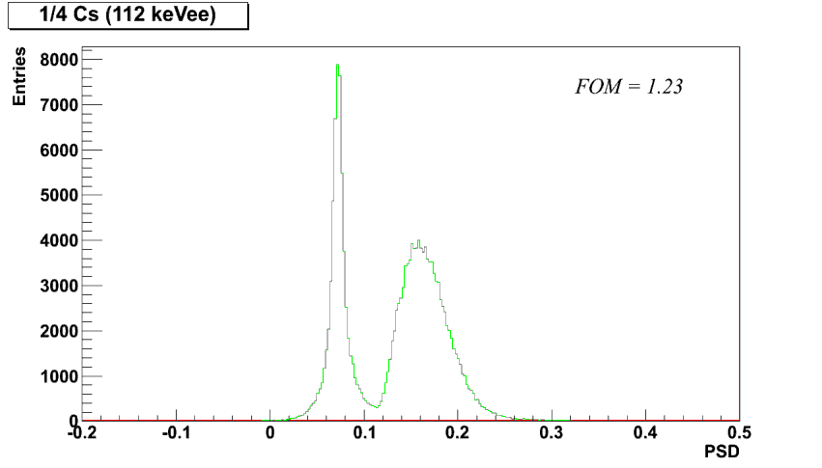
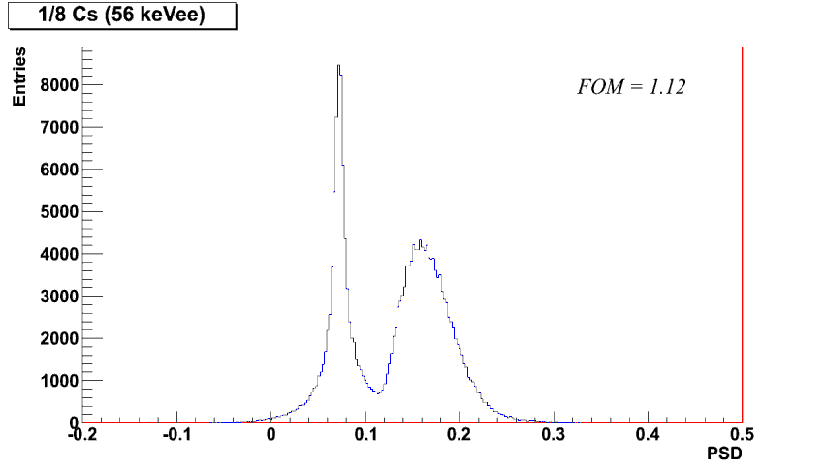
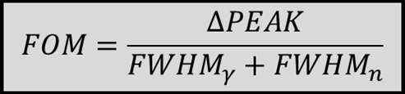
γ-n Discrimination: test results (III)
Reproduction, transfer, distribution of part or all of the contents in this document in any form without prior written permission of CAEN S.p.A. is prohibited
Notes:
32

Slide 33
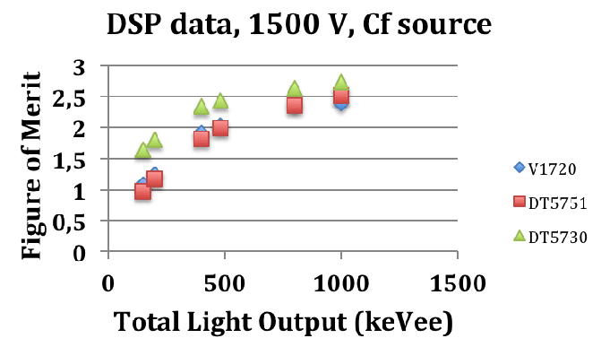
γ-n Discrimination: Comparing boards
Reproduction, transfer, distribution of part or all of the contents in this document in any form without prior written permission of CAEN S.p.A. is prohibited
Notes:
33

Slide 34
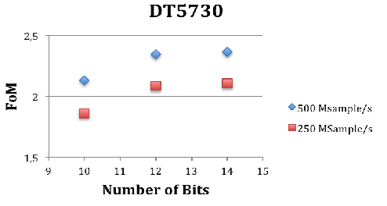
γ-n Discrimination: bits and sampling rate
10 bits are not sufficient; 14 are not significant; 12 is OK
Big improvement from 250 to 500 MS/s
Reproduction, transfer, distribution of part or all of the contents in this document in any form without prior written permission of CAEN S.p.A. is prohibited
Notes:
34

Slide 35
TIMING ANALYSIS
Reproduction, transfer, distribution of part or all of the contents in this document in any form without prior written permission of CAEN S.p.A. is prohibited
Notes:
35

Slide 36
Conventional TDCs vs Digitizers
Conventional TDC boards:
  V1190: 128 channel, 100 ps Multi-Hit TDC
  V1290: 32 channel, 25 ps Multi-Hit TDC
  V775: 32 channel, 35 ps Start-Stop TDC
TDC in a digitizer can't compete in terms of density and cost, but there are cases where the implementation of a TDC in a digitizer is profitable:
  Applications that require an excellent timing resolution (5 ps) of the whole chain (CFD+TDC)
  Simultaneous acquisition of Timing and Energy: digitizers do both
  Walk correction with the energy
  Bursts of very close pulses (e.g. Free Electron Lasers): the digitizer can operate without dead time
  Direct connection from detector to digitizer (no discriminators!). Less cables, less distortion… eventually less cost!
external
CFD required!
Reproduction, transfer, distribution of part or all of the contents in this document in any form without prior written permission of CAEN S.p.A. is prohibited
Notes:
36

Slide 37
Algorithms for the Time Measurements
Digital CFD: S_{CFD}(n) = A*S_{IN}(n) - S_{IN}(n-D), A=Attenuation, D=Delay
Interpolation between samples necessary to improve timing resolution beyond the granularity of the sampling period
Linear interpolation (segment between two samples) is simple and effective in most cases; can be implemented in the FPGA
timing resolution is function of the sampling frequency, pulse amplitude and rise-time (i.e. δV/δT)
Rule of thumb: 4-5 samples in the leading edge to get good and stable timing resolution
Reproduction, transfer, distribution of part or all of the contents in this document in any form without prior written permission of CAEN S.p.A. is prohibited
Notes:
37

Slide 38
Timing Resolution (ps RMS)
START-STOP PULSES: 1 Vpp
 | Leading Edge
Board Type | 0.8 ns | 1.6 ns | 2.5 ns | 5 ns | 10 ns
2GS/s 10bit (x751) | 14 | 9 | - | - | -
4GS/s 10bit (x761) | 6 | 6 | - | - | -
Switched Capacitor ADCs (x742/x743) | 5 | 5 | - | - | -
500MS/s 14 bit (x730) (*) | - | - | 126 | 30 | 10
500MS/s 14 bit (x730) (*) + input shaper | - | 12 | - | - | -
Analog CFD+TDC | 50 | 50 | 43 | - | -
(*) digital CFD + time stamp interpolation on-line in the x730 (no waveform readout) and soon in the x743 too.
Reproduction, transfer, distribution of part or all of the contents in this document in any form without prior written permission of CAEN S.p.A. is prohibited
Notes:
38

Slide 39
SINLE BOARD for MULTI ANALYSIS
Reproduction, transfer, distribution of part or all of the contents in this document in any form without prior written permission of CAEN S.p.A. is prohibited
Notes:
39

Slide 40
An example: Phoswitch+LaBr detectors
Requirements:
Phoswitch detectors (e.g. NaI + LaBr₃) require Pulse Shape Discrimination to separate events that interact in one or in the other crystal
Wide energy dynamic range (40KeV to 40MeV)
Precise Timing information
Multi-parametric analysis
PSD and Energy windowing
One single board (x730) directly connected to the detectors (either LaBr₃ or Phoswitch) is able to manage the acquisition
Reproduction, transfer, distribution of part or all of the contents in this document in any form without prior written permission of CAEN S.p.A. is prohibited
Notes:
40

Slide 41
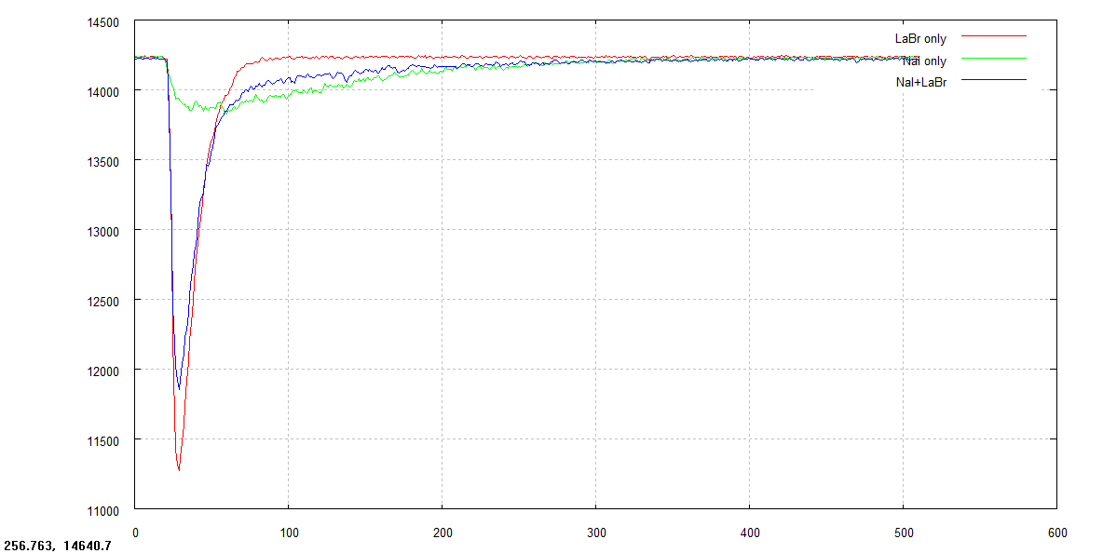
Waveforms
Phoswitch: Different Pulse Shape for interactions in LaBr₃, NaI or scattered in both (Compton)
Reproduction, transfer, distribution of part or all of the contents in this document in any form without prior written permission of CAEN S.p.A. is prohibited
Notes:
41

Slide 42
Energy Spectrum
Energy Range up to 44MeV
Resolution in LaBr₃: 19.2 KeV @ 662 KeV (2.9%)
8.6 KeV @ 80 KeV (10.7%)
Reproduction, transfer, distribution of part or all of the contents in this document in any form without prior written permission of CAEN S.p.A. is prohibited
Notes:
42

Slide 43
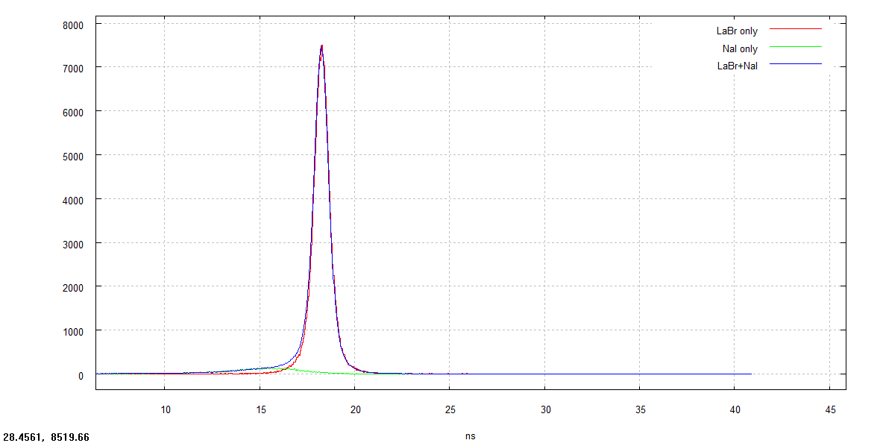
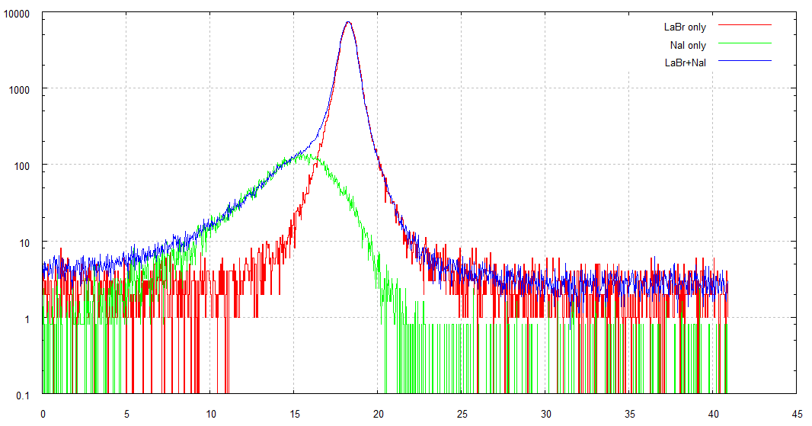
Time of Flight Spectrum
3”x3” LaBr₃ to Phoswitch Time Of Flight
Resolution = down to ~500 ps FWHM depending on the energy range windowing (mainly due to intrinsic resolution of the large detector)
Reproduction, transfer, distribution of part or all of the contents in this document in any form without prior written permission of CAEN S.p.A. is prohibited
Notes:
43

Slide 44
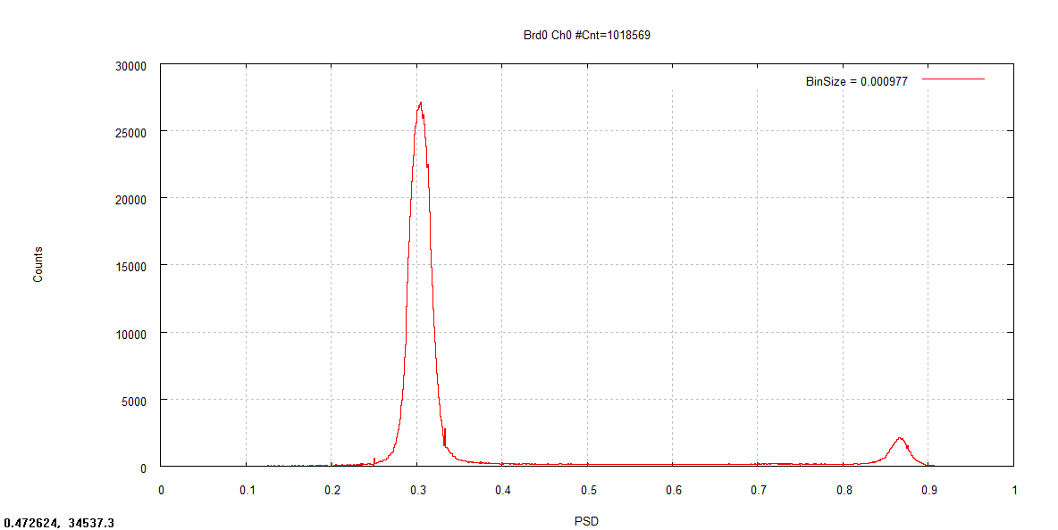
Pulse Shape Discrimination
Very good separation between events in LaBr₃ and NaI
Events in LaBr₃
Events in NaI
Reproduction, transfer, distribution of part or all of the contents in this document in any form without prior written permission of CAEN S.p.A. is prohibited
Notes:
44

Slide 45
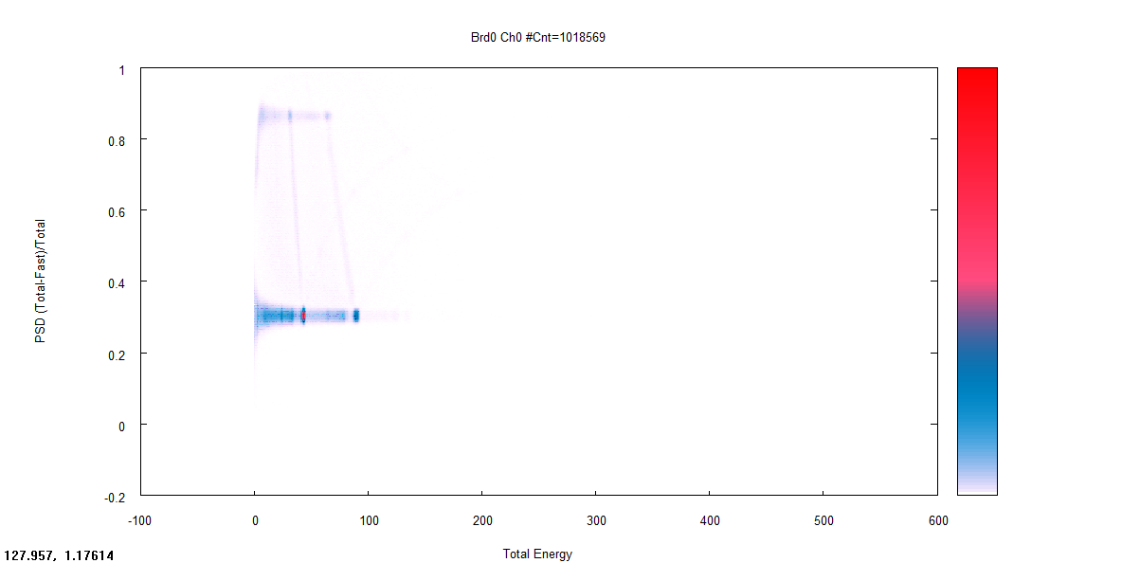
Energy vs PSD scatter plot
Reproduction, transfer, distribution of part or all of the contents in this document in any form without prior written permission of CAEN S.p.A. is prohibited
Notes:
45

Slide 46
SOFTWARE TOOLS AND LIBRARIES
Reproduction, transfer, distribution of part or all of the contents in this document in any form without prior written permission of CAEN S.p.A. is prohibited
Notes:
46

Slide 47
Software for the digitizers
CAEN provides a wide range of software tools to configure and to control the data acquisition
  Linux and Windows OS compatible (32 and 64 bits)
  Free download
DRIVERS for the communication channel:
  CONET2 – optical link
  VME bus
  USB
LIBRARIES:
  C and LabView
  Demo and examples available for developers
READOUT SOFTWARE:
  Medium and high level tools to manage the configuration and the data acquisition
Reproduction, transfer, distribution of part or all of the contents in this document in any form without prior written permission of CAEN S.p.A. is prohibited
Notes:
47

Slide 48

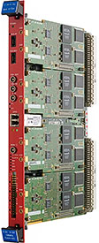

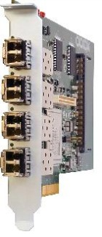

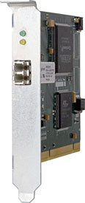
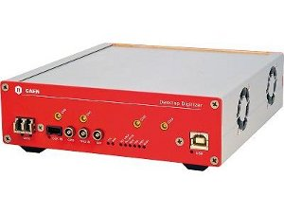
Libraries and drivers
User Applications
CAENDigitizer library
Set/Get Params, Start/Stop Read Events, etc.
CAENcomm library
CONET2 (Optical Link)
Open/Close, Read, Write
A2818
driver
A3818
driver
USB
driver
V1718
driver
PCI
PCIe
USB
USB
VME
Reproduction, transfer, distribution of part or all of the contents in this document in any form without prior written permission of CAEN S.p.A. is prohibited
Notes:
48

Slide 49

DPP libraries for spectroscopy software
Spectroscopy Applications
Config
GUI
DPP library
LIST
HISTO
WAVE
Socket
DPPcore
Output
CAENDigitizer library
Acquisition
Server
CAENcomm library
Drivers
USB, PCI, PCIe
Digitizers
Hardware
Reproduction, transfer, distribution of part or all of the contents in this document in any form without prior written permission of CAEN S.p.A. is prohibited
Notes:
49

Slide 50
Next: DPP Event Oriented DAQ
SETTING PANEL
Selection Criteria
Hardware
Readout Server
Data Analysis
Config
Params
GUI
Find
Devices
Data Flow
Configuration
x724
x720
x730
x751
…
Configurator
E-histo
Time,
Energy,
PSD
T-histo
Readout
Throttle
Histogrammer
HISTO PLOTS &
STATISTICS MONITOR
Pre-Processor
Event Selector
PSD-histo
MCS
HW
Biparam-histo
RATE MONITOR
DataFile
Waves
SIGNAL
SCOPE
Waveforms
Lists
Spectra
Reproduction, transfer, distribution of part or all of the contents in this document in any form without prior written permission of CAEN S.p.A. is prohibited
Notes:
50

